Slide 1
Industrial Training
Briefing
SEMESTER I 2021/2022
FSKTM, UTHM
Monday, 5th April 2021

Slide 2
Outlines
Industrial Training Overview
Industrial Training Committee and PKKA
Industrial Training Application Process
Application Procedures
How to Choose a company?
Internship Preparation
Pre-Industrial Training Activities
Industrial Training Guidelines
Industrial Training Online Registration Manual.

Slide 3

When are you eligible to go for Industrial Training?
Course registration BIT40112/BIC 41812 Industrial Training
Completed at least 70 % of the course subjects.

Slide 4
BIT 40112/BIC 41812 Industrial Training
Students have to undergo 24 weeks of practical training at any government or private agencies. During the training, they will be given assignments or projects, which are approved earlier by the faculty and the agencies based on their majors.

Slide 5
Why go for Industrial Training?
Adapting to working environment that related to ICT field
Improve skill – practical / theoretical /social
Increase knowledge
Gain experience
Part of the curriculum

Slide 6
By the end of the course, students should be able to:
develop value, moral and professional ethics in working environment. (C5, EM)
adapt skills and knowledge gained from university to industry. (P6, Practical Skills)
report industrial training outcome verbally and written. (A3, CS)
Learning Outcome

Slide 7
Scope of Training
Information System
Information Security
Multimedia
Software Engineering
IT/CS
Web Technology

Slide 8
Expectation to industry
Students are expected to be involved in the following areas:
Documentation and testing new software applications
Web design and development
Hardware architecture and construction
Network design and engineering
Develop system/applications (coding, programming)
Multimedia
Security tool implementation, integration, and performance evaluation
IT Project management related task
Upon completion of this industrial training, the students are expected to possess certain level of technical competency, particularly related to their respective field of studies.

Slide 9
Industrial Training Committee
Dean: Ts. Dr. AZIZUL AZHAR BIN RAMLI
HEPA PUAN MUNIRAH BINTI MOHD YUSOF
TDAA Dr. ZUBAILE BIN ABDULLAH
Head of Department Software Engineering Dr. MOHAMAD AIZI BIN SALAMAT
Head of Department Information Security & Web Technology Dr. NURUL AZMA BINTI ABDULLAH
Head of Department Multimedia Dr. RAHAYU BINTI A HAMID
Industrial Training Coordinator Dr. MUHAINI OTHMAN
Notes:
9

Slide 10
DR. MUHAINI OTHMAN
Tel No (O) : 074533712
H/P : 0197462388
Fax : 074533652
Email : muhaini@uthm.edu.my
Industrial Training Coordinator
Please Send Me a Message via Email, Whatapps, FB. Will get back to you when available. Only call when it is urgent.
Notes:
10

Slide 11
Coordinator responsibilities
Giving Industrial Training Briefings
Setting suitable dates for Industrial Training
Monitor student registrations and application by checking whether the companies are suitable.
Assign faculty supervisors and schedule industrial visits
Collect marks from faculty supervisors and industrial supervisors
Collect all materials regarding industrial training.

Slide 12
Who are responsible to manage your applications to companies?
PUSAT KERJAYA DAN ALUMNI(PKKA) & HEP
PKKA - Handle all matter related to industrial training and eLI system
HEP handle indemnity letter
Puan Zailiya binti Suradi (Off: 07-453 7457, email : li@uthm.edu.my , zailiya@uthm.edu.my)
Pn Suhailah binti Muhammad Philip (Off: 07-4564008, suhailah@uthm.edu.my)

Slide 13
Industrial Training Online Registration
via e-LI
New e-LI functions student can-
print their of cover letter
Print LI confirmation letter
Print rejection letter
Application to register new companies
E-logbook

Slide 14
Industrial Training Application Process
Before confirmation of placement
Start
Register Internship Semester in eLI system (5 April – 4 May 2021)
Coordinator verify the registration application via eLI
A

Slide 15
A
Update CV in eLI
Are all the companies you want listed?
C
Yes
No
Choose MAXIMUM 3 companies from the list at one time
Add new company by clicking “syarikat tiada dalam senarai”
Wait for Coordinator Approval (1-3 days)
B

Slide 16
B
Do you want to accept it?
Print cover letter and CV
No
Yes
Confirm your placement with PKKA
Confirm your rejection to PKKA (formal letter), Print the rejection letter from eLI and send to the company.
Send to the companies (email/post)
Update internship placement info after starting internship in eLI
Student checks if there any offer letter from companies at PKKA
(after 2-4 weeks)
Check subject registration for BIT40112/BIC 41812 Latihan Industri during subject registration weeks (automatic registered from eLI***)
Is there any offer?
No
Yes
C
End

Slide 17
Application Procedures
Via PKKA:e-LI (Industrial Training Registration Online)
Choose maximum 1-3 companies at a time.
If rejected then apply again.
This method is preferable since most companies prefer to receive formal letter from the University
**Coordinator have the right to reject student’s choice of company if it does not comply to condition set out by the committee.
If your quota is full, please email me to add one more quota with an evidence of rejection from company

Slide 18
Guide to LI
Send cover letter and CV to all potential companies and called them to confirmed they received your CV.
Be proactive, do not wait for offers called them up to ask about their decision. If their respond are negative find other companies.
Find a place before the date of industrial training start.
If they don’t have an IT department and need your help in developing software or system, please do apply.
If you have two or more offers, ask the companies if they wanted a replacement (among your friend) before rejecting the offers.
Ask lecturers about their connections with companies.

Slide 19
How to choose a company?
Choose a company:
That has an IT department and have the expertise that can guide the student during training.
In MALAYSIA only. If you want to do LI outside Malaysia, please consult PKKA.
In Pandemic era – Student are allowed to find a company that provide work from home but make sure the company also have physical company.

Slide 20
Not Advisable to Apply to these Companies
Schools, Polytechnics, Hospitals, City councils, Pejabat Setiausaha Kerajaan Negeri (depends on which government offices- consult Coordinator first!)
Organization without an IT department.
Organization without any IT staff to supervise you.
Telecommunications company – work related to Electrical and electronic

Slide 21
Internship Preparation
Prepare your resume
Check grammar and spelling mistake
Picture must be presentable
Email Address
List your skills and experience
Undergraduate project (PSM)
Training attended
Check for templates
Jobstreet.com
Choose a suitable company
Research via website
Ask seniors
Refer to previous internship list in Latihan Industri FB Page
Go to the company

Slide 22
WARNING!
Student are not advisable to apply the company themselves. MUST apply through eLI System.
Student who are caught forging the cover letter or any forms from eLI to apply on their own will be given HG for LI subject.
Student who forget to give notice of rejection the company they apply will be given HG.
Student who change the company placement without TDAA and coordinator permission will be given HG.

Slide 23
1.2.7 Keputusan Hadir Gagal (HG) daripada Panduan LI
Pelajar dikira GAGAL sekiranya:
Tidak menjalani LI atau memalsukan kehadiran dan tiada rekod tarik diri setelah membuat pengakuan menerima tawaran LI.
Menukar penempatan LI tanpa mendapat kelulusan bertulis daripada Timbalan Dekan (Akademik dan Antarabangsa) fakulti/ pusat akademik.
Menjalani LI kurang daripada tempoh minimum 80% kehadiran yang telah ditetapkan dalam program akademik fakulti.
Tidak menghantar laporan dan buku log pada tarikh yang telah ditetapkan setelah tamat menjalani LI. (Sila rujuk Perkara 29(2)(b) dalam Peraturan Akademik, UTHM).
Membuat pemalsuan dokumen atau maklumat berkaitan dengan LI, seperti memalsukan surat tawaran, buku log, buku laporan, surat pengakuan kehadiran, sijil cuti sakit dan sijil cuti kematian ahli keluarga terdekat.

Slide 24
The Impact of Incorrect Company Selection !!
Student will ask permission to change company with 101 reasons.
Company will feel disappointed at FSKTM student.
Indirectly, it will affect the good name of faculty and university.
Then, university will be BLACK LISTED by the company.
Finally, no placement to your junior or difficult for the university to joint venture with them regarding research or other matters.

Slide 25


Slide 26
PRE- INDUSTRIAL TRAINING ACTIVITIES
 | Activities | Date/ Duration | Location/ Website | Person/s Involved
1. | Attend First Briefing on Industrial Training (THURSDAY) | 5th April 2021 | Online | LI Coordinator, Student.
2. | LI registration & Update resume | 5th April 2021 – 4th May 2021 | e-LI | Student
3. | Apply internship application to 1 - 3 companies in | 5th April 2021 – until offered placement | e-LI | Student, PKKA
4. | Check for any offer letters - (if no offer, resubmit application to other companies), email offer letter to PKKA (li@uthm.edu.my) | Weekly after registration until offer is received | PKKA, e-LI | Student, PKKA (Pn Zailiya)
5. | Attend Second Briefing | June/July 2021 | Online | LI Coordinator, Student
6. | Start Internship | 16th August 2021 – 28th Jan 2022 | Organization around Malaysia | Student
7. | Check name already registered automatically for BIT 40112/BIC 41812 Latihan Industri during Course Registration Week. | Please update with PPA (expected in September 2021) | SMAP | Student, PA, Faculty

Slide 27
IMPORTANT TASK BEFORE STARTING INTERNSHIP
Internship Registration in eLI System will be opened only 1 months from 5th April 2021 to 4th May 2021
Student must select at least 1 company to max 3 Companies max at one time – student can add more if there is no offer/rejection from company (within 2-3 weeks). Please send email to coordinator to add more company.
Student Print cover letter, cv and reply form and send to the company
Company must send reply form to PKKA (li@uthm.edu.my) (Thru email/fax/post)
Student must accept the first offer (if want to change please write a letter to coordinator and ask for written support)
If student not doing internship send letter to coordinator
Student must print rejection letter to other companies and send to the companies.
If student fail to find companies within the specified time ask for extension. (extension of not more than 2 weeks will be given based on circumstances)

Slide 28
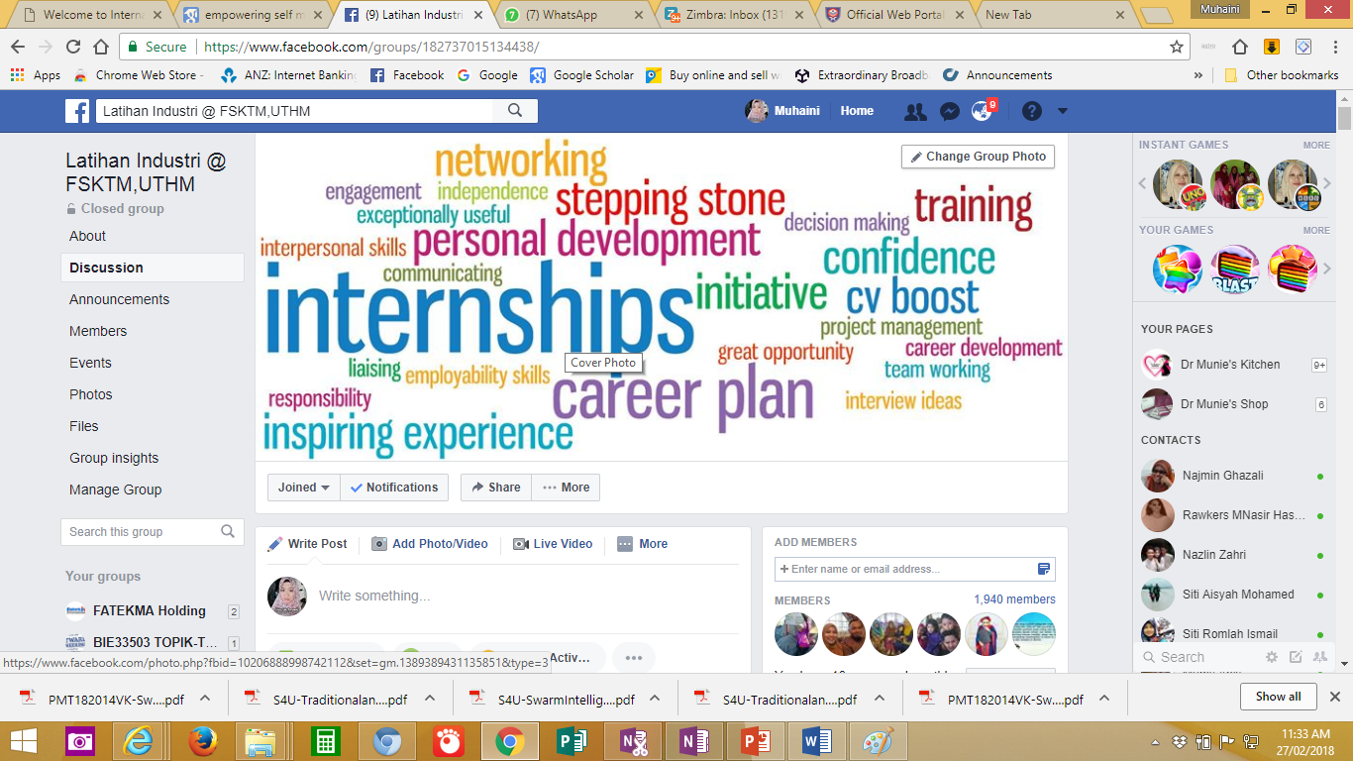
Join FB group Latihan Industri @ FSKTM, UTHM Stay informed!
Please subscribe to Telegram Channel for faster information and Q&A
https://t.me/joinchat/l2qw2ur_kl4zZWRl
Telegram group link to this channel
https://t.me/joinchat/eWNWv4a4ea5lOTE1

Slide 29
eLI System Demonstration
Oleh:
Ts. Dr. MOHD FAHRUL BIN HASSAN
(Ketua Jabatan Latihan Industri Pelajar)
Email : fahrul@uthm.edu.my
Office no. : 07-4537866

Slide 30

THANK YOU
AND
GOOD LUCK

